Slide 1
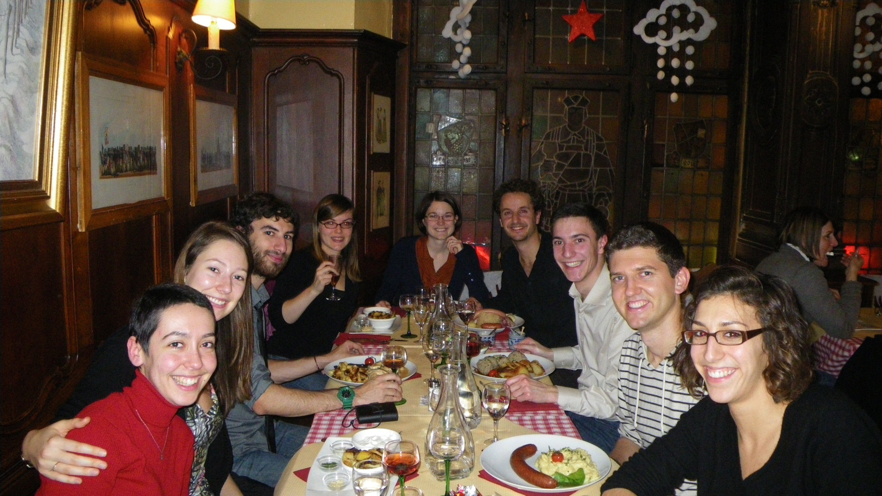
décembre 2011

Slide 2
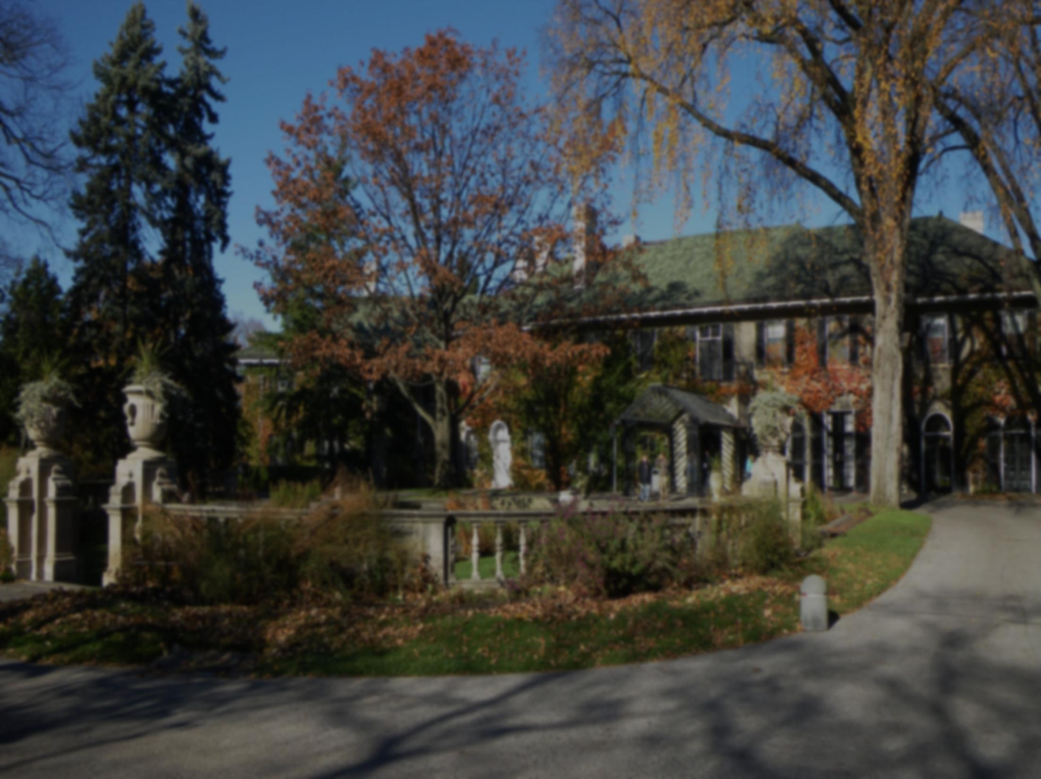
Mortality
Oh hope and despondency, pleasure and pain, Are mingled together in sunshine and rain; And the smile and the tear, the song and the dirge, Still follow each other, like surge upon surge.
'Tis the wink of an eye -- 'tis the draught of a breath-- From the blossom of health to the paleness of death, From the gilded saloon to the bier and the shroud:-- Oh! why should the spirit of mortal be proud?
William Knox (1789-1825)

